Slide 1
Methods – on strings and other things
Strings, revisited
Objects and their methods
Indexing and slicing
Some commonly used string methods

Slide 2
What is a string?
A string is a sequence of zero or more characters
A string is delimited (begins and ends) by single or double quotes
poem = 'Ode to a Nightingale'
lyric = "Roll on, Columbia, roll on"
exclamation = "That makes me !#? "
The empty string has zero characters ('' or "")

Slide 3
Quote characters in strings
You can include a single quote in a double quoted string or a double quote in a single quoted string
will = "All the world's a stage"
ben = 'BF: "A penny saved is a penny earned"'
To put a single quote in a single quoted string, precede it with the backslash ('\') or 'escape' character.
>>> will = 'All the world\'s a stage'
>>> print(will)
All the world's a stage
The same goes for double quotes
>>> ben = "BF: \"A penny saved is a penny earned\""
>>> print(ben)
BF: "A penny saved is a penny earned"

Slide 4
Putting a format character in a string
A format character is interpreted by the print() function to change the layout of text
To put a format character in a string, precede it with the backslash ('\')
A newline is represented by '\n'
>>> juliette = 'Good night, good night\nParting is such sweet sorrow'
>>> print(juliette)
Good night, good night
Parting is such sweet sorrow
A tab is represented by '\t'
>>> tabs = 'col0\tcol1\tcol2'
>>> print(tabs)
col0 col1 col2

Slide 5
Index of string characters
The first character of a string has index 0
>>> greeting = 'hello, world'
>>> greeting[0]
'h'
>>> 'hello, world'[0]
'h'
You can also count back from the end of a string, beginning with -1
>>> greeting = 'hello, world'
>>> greeting[-1]
'd'
>>> 'hello, world'[-1]
'd'

Slide 6
Slicing a string
You can use indexes to slice (extract a piece of) a string
aStr[i:j] is the substring that begins with index i and ends with (but does not include) index j
>>> greeting = 'hello, world'
>>> greeting[1:3]
'el'
>>> greeting[-3:-1]
'rl'
omit begin or end to mean 'as far as you can go'
>>> print(greeting[:4], greeting[7:])
hell world
aStr[i:j:k] is the same, but takes only every k-th character
>>> greeting[3:10:2]
'l,wr'

Slide 7
Index/slice a string vs index/slice a list
How they're the same and how they're different
SAME:
  You can index a list or string by providing an integer index value, beginning with 0 from the left or -1 from the right [i].
  You can slice a list or string by providing begin and end values ([i:j]) or begin, end and step values ([i:j:k])
  You can omit begin or end ([:j] or [i:]) to mean 'as far as you can go'

Slide 8
List index vs string index (continued)
DIFFERENT:
  if you reference a single element of a list with the index operator ([i]), its type is the type of that element
>>> abc = ['a', 'b', 'c']
>>> abc[0]
'a'
>>> type(abc[0])
<class 'str'>
  If you slice (extract a piece of) a list with begin and end ([i:j]) values, you get a sublist (type list)
>>> abc[0:2]
['a', 'b']
>>> type(abc[0:2])
<class 'list'>

Slide 9
String methods
A method is a function that is bundled together with a particular type of object
A string method is a function that works on a string
This is the syntax of a method:
anObject.methodName(parameterList)
For example,
>>> 'avocado'.index('a')
0
returns the index of the first 'a' in 'avocado'
You can also use a variable of type string
>>> fruit = 'avocado'
>>> fruit.index('a')
0

Slide 10
Method parameters
Like any function, a method has zero or more parameters
Even if the parameter list is empty, the method still works on the 'calling' object:
>>> 's'.isupper()
False
Here is a string method that takes two parameters:
>>> aStr = 'my cat is catatonic'
>>> aStr.replace('cat', 'dog')
'my dog is dogatonic'

Slide 11
Strings are immutable
A string is immutable -- once created it can not be modified
When a string method returns a string, it is a different object; the original string is not changed
>>> aStr = 'my cat is catatonic'
>>> newStr = aStr.replace('cat', 'dog')
>>> newStr
'my dog is dogatonic'
>>> aStr
'my cat is catatonic'
However, you can associate the old string name with the new object
>>> aStr = 'my cat is catatonic'
>>> aStr = aStr.replace('cat', 'dog')
>>> aStr
'my dog is dogatonic'

Slide 12
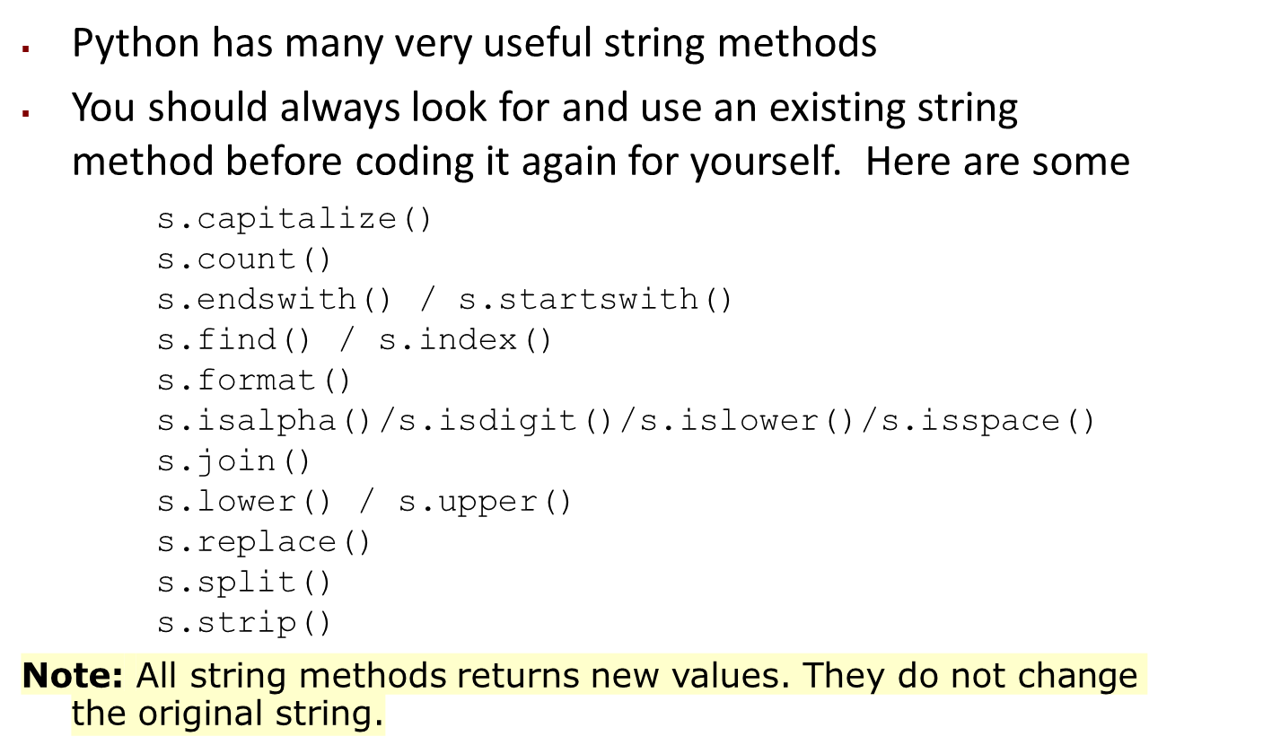
Python string methods

Slide 13
The split method
The string method split() lets us separate a string into useful parts
  Common use: splitting a sentence into its words
Splits by space characters by default, but you can give it a different 'separator' string
>>> s = "Captain, incoming transmission!"
>>> print(s.split())
['Captain,', 'incoming', 'transmission!']
>>> s = "a one, a two, a one two three four"
>>> print(s.split(', '))
['a one', 'a two', 'a one two three four']

Slide 14
The strip method
The strip() method removes any leading, and trailing whitespaces.
Leading means at the beginning of the string, trailing means at the end.
You can specify which character(s) to remove, if not, any whitespaces will be removed.
The string method strip() “cleans” the edges of a string by removing the character(s) you specify (default: spaces)
>>> s = "(hello!)"
>>> print(s.strip("()!"))
hello
The string module contains a useful variable for this, called punctuation (like how the math module has pi)
>>> import string
>>> string.punctuation
'!"#$%&\'()*+,-./:;<=>?@[\\]^_`{|}~'

Slide 15
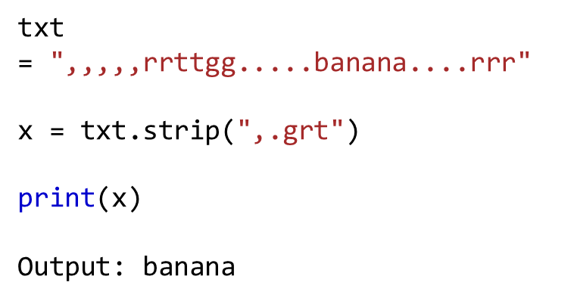

Slide 16
Using split() and strip() together
The split method is useful for extracting words, and the strip method is useful for cleaning them up
Remember that strip() is a string method, not a list method
>>> import string
>>> words = ['How', 'are', 'you,', 'sir?']
>>> print(s.strip(string.punctuation))
AttributeError: 'list' object has no attribute 'strip'
So, how can we clean up every word in a sentence, once we've split it?

Slide 17
Using split() and strip() together
The strip() method works on one “word” at a time
So, take it one word at a time
>>> import string
>>> words = ["It's", 'warm', 'today,', 'yeah?']
>>> for item in words:
print(item.strip(string.punctuation))
It's
warm
today
yeah
Side question: why can't we just use the replace() method to get rid of punctuation like this?

Slide 18
Python string method documentation
You can find the meaning of each of these string methods in the Python documentation
Some operations on strings also work with other sequence types, both mutable and immutable. For example:
x in s
x not in s
s + t
s*n / n*s
len(s)
min(s)
max(s)

Slide 19
Strings and the print() function
The print() function always prints a string. The input() function always inputs a string.
Every object in Python has a string representation. Therefore, every object can be printed.
When you print a number, a list or a function it is the string representation of the object that is printed
print() takes 0 or more arguments and prints their string representations, separated by spaces
>>> print('pi =', 3.14)
pi = 3.14
>>> def f():
pass
>>> print(f)
<function f at 0x02C4BD20>

Slide 20
The print separator and end
By default, print() separates multiple outputs with spaces
You can change this to any string that you want, for example, a colon and a space (': ')
>>> print(1, 2, 3, sep=': ')
1: 2: 3
By default, print() ends its output with a newline ('\n')
>>> for i in range(3):
print(i)
0
1
2
You can change this, for example, to a hyphen
>>>for i in range(3):
print(i, end='-')
0-1-2-

Slide 21
The string format method
The string format() method allows you detailed control over what is printed and its arrangement (including alignment; width; your choice of date, time and number formats; and many other things).
Here is an example of how s.format() can be used to control what is printed:
>>> print('{} is {}'.format('Big Bird', 'yellow'))
Big Bird is yellow
>>> print('{} is {}'.format('Oscar', 'grumpy'))
Oscar is grumpy
https://www.w3schools.com/python/python_ref_string.asp

Slide 22
Built-in String Methods:
1 | capitalize()
 | Capitalizes first letter of string
2 | center(width, fillchar)
 | Returns a space-padded string with the original string centered to a total of width columns
3 | count(str, beg= 0,end=len(string))
 | Counts how many times str occurs in string, or in a substring of string if starting index beg and ending index end are given
3 | decode(encoding='UTF-8',errors='strict')
 | Decodes the string using the codec registered for encoding. encoding defaults to the default string encoding.
4 | encode(encoding='UTF-8',errors='strict')
 | Returns encoded string version of string; on error, default is to raise a ValueError unless errors is given with 'ignore' or 'replace'.
5 | endswith(suffix, beg=0, end=len(string))
 | Determines if string or a substring of string (if starting index beg and ending index end are given) ends with suffix; Returns true if so, and false otherwise
6 | expandtabs(tabsize=8)
 | Expands tabs in string to multiple spaces; defaults to 8 spaces per tab if tabsize not provided

Slide 23
7 | find(str, beg=0 end=len(string))
 | Determine if str occurs in string, or in a substring of string if starting index beg and ending index end are given; returns index if found and -1 otherwise
8 | index(str, beg=0, end=len(string))
 | Same as find(), but raises an exception if str not found
9 | isa1num()
 | Returns true if string has at least 1 character and all characters are alphanumeric and false otherwise
10 | isalpha()
 | Returns true if string has at least 1 character and all characters are alphabetic and false otherwise
11 | isdigit()
 | Returns true if string contains only digits and false otherwise
12 | islower()
 | Returns true if string has at least 1 cased character and all cased characters are in lowercase and false otherwise
13 | isnumeric()
 | Returns true if a unicode string contains only numeric characters and false otherwise
14 | isspace()
 | Returns true if string contains only whitespace characters and false otherwise

Slide 24
15 | istitle()
 | Returns true if string is properly "titlecased" and false otherwise
16 | isupper()
 | Returns true if string has at least one cased character and all cased characters are in uppercase and false otherwise
17 | join(seq)
 | Merges (concatenates) the string representations of elements in sequence seq into a string, with separator string
18 | len(string)
 | Returns the length of the string
19 | ljust(width[, fillchar])
 | Returns a space-padded string with the original string left-justified to a total of width columns
20 | lower()
 | Converts all uppercase letters in string to lowercase
21 | lstrip()
 | Removes all leading whitespace in string
22 | maketrans()
 | Returns a translation table to be used in translate function.
23 | max(str)
 | Returns the max alphabetical character from the string str

Slide 25
24 | min(str)
 | Returns the min alphabetical character from the string str
25 | replace(old, new [, max])
 | Replaces all occurrences of old in string with new, or at most max occurrences if max given
26 | rfind(str, beg=0,end=len(string))
 | Same as find(), but search backwards in string
27 | rindex( str, beg=0, end=len(string))
 | Same as index(), but search backwards in string
28 | rjust(width,[, fillchar])
 | Returns a space-padded string with the original string right-justified to a total of width columns.
29 | rstrip()
 | Removes all trailing whitespace of string
30 | split(str="", num=string.count(str))
 | Splits string according to delimiter str (space if not provided) and returns list of substrings; split into at most num substrings if given
31 | splitlines( num=string.count('\n'))
 | Splits string at all (or num) NEWLINEs and returns a list of each line with NEWLINEs removed

Slide 26
32 | startswith(str, beg=0,end=len(string))
 | Determines if string or a substring of string (if starting index beg and ending index end are given) starts with substring str; Returns true if so, and false otherwise
33 | strip([chars])
 | Performs both lstrip() and rstrip() on string
34 | swapcase()
 | Inverts case for all letters in string
35 | title()
 | Returns "titlecased" version of string, that is, all words begin with uppercase, and the rest are lowercase
36 | translate(table, deletechars="")
 | Translates string according to translation table str(256 chars), removing those in the del string
37 | upper()
 | Converts lowercase letters in string to uppercase
38 | zfill (width)
 | Returns original string leftpadded with zeros to a total of width characters; intended for numbers, zfill() retains any sign given (less one zero)
39 | isdecimal()
 | Returns true if a unicode string contains only decimal characters and false otherwise

Slide 27

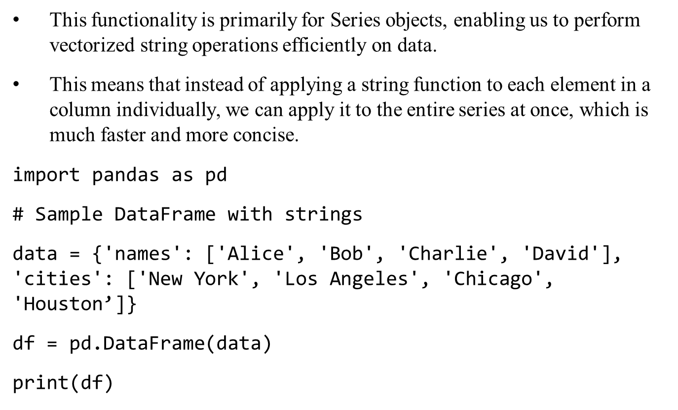

Slide 28

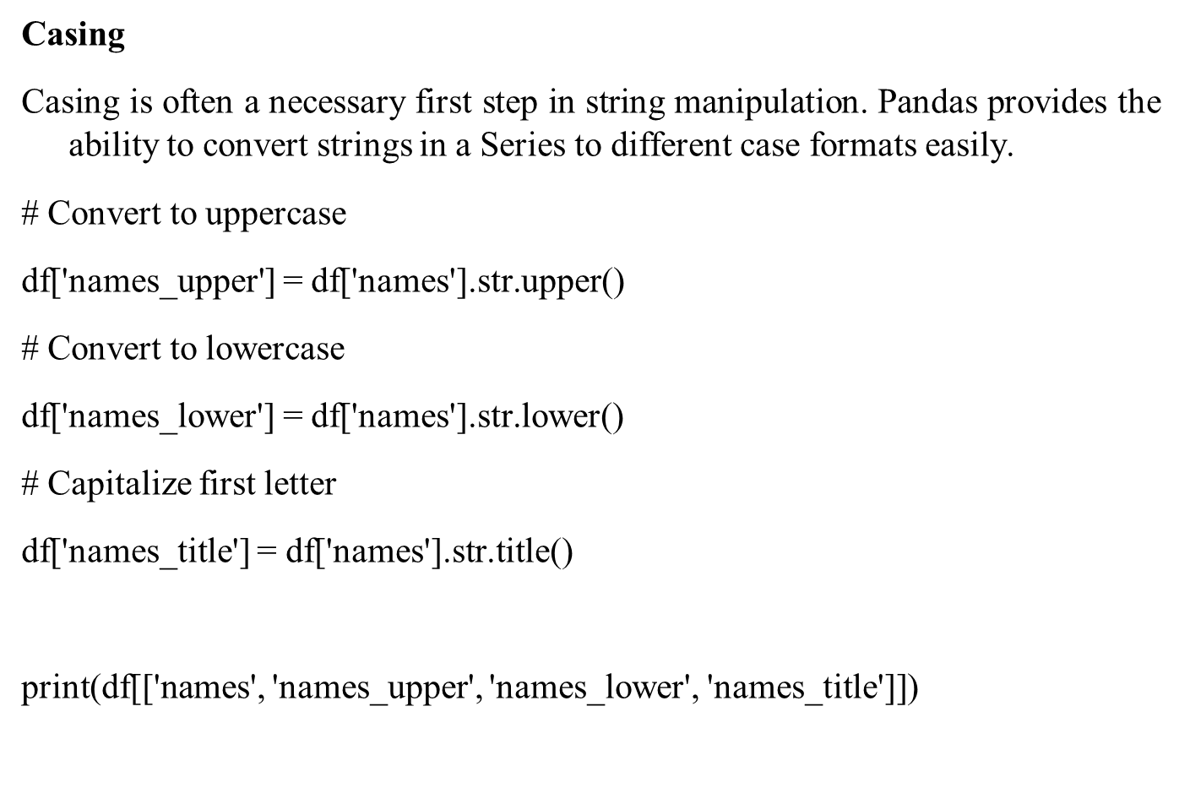

Slide 29
Output
names names_upper names_lower names_title
0 Alice ALICE alice Alice
1 Bob BOB bob Bob
2 Charlie CHARLIE charlie Charlie
3 David DAVID david David

Slide 30
Input
names cities
0 Alice New York
1 Bob Los Angeles
2 Charlie Chicago
3 David Houston
2/28/17

Slide 31

# Check if substring 'New' is in cities
contains_new = df['cities'].str.contains('New')
# Replace 'New' with 'Old'
df['cities'] = df['cities'].str.replace('New', 'Old')
print(contains_new)
print(df)

Slide 32
Output:
0 True
1 False
2 False
3 False
Name: cities, dtype: bool
names cities
0 Alice Old York
1 Bob Los Angeles
2 Charlie Chicago
3 David Houston

Slide 33

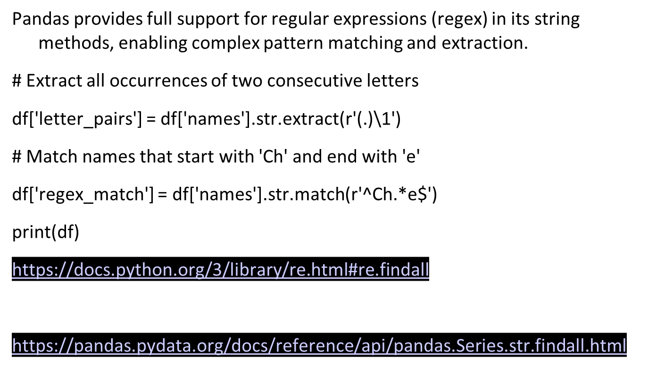

Slide 34
# Extract all occurrences of two consecutive letters df['letter_pairs'] = df['names'].str.extract(r'(.)\1')
Purpose: This line is used to find and extract pairs of consecutive identical characters (like "ee" in "see" or "tt" in "letter") from the names column in the DataFrame.
• Details:
r'(.)\1' is a regular expression pattern.
  (.) captures any single character.
  \1 is a backreference to the first captured group, meaning it matches the same character again.
.str.extract() is a method in pandas that applies the regular expression and extracts matching groups.
If a name in the names column contains consecutive identical characters, that pair will be extracted and stored in the letter_pairs column.
2/28/17

Slide 35
# Match names that start with 'Ch' and end with 'e' df['regex_match'] = df['names'].str.match(r'^Ch.*e$')
Purpose: This line checks whether the names in the names column start with "Ch" and end with "e", and returns a boolean value (True or False) for each name.
• Details:
r'^Ch.*e$' is the regular expression pattern.
  ^Ch asserts that the name should start with "Ch".
  .* allows any characters (0 or more) to follow.
  e$ asserts that the name should end with "e".
.str.match() checks if the entire string matches the given pattern and returns True or False.
2/28/17

Slide 36
Output
names cities letter_pairs regex_match
0 Alice Old York l False
1 Bob Los Angeles NaN False
2 Charlie Chicago l True
3 David Houston NaN False

Slide 37

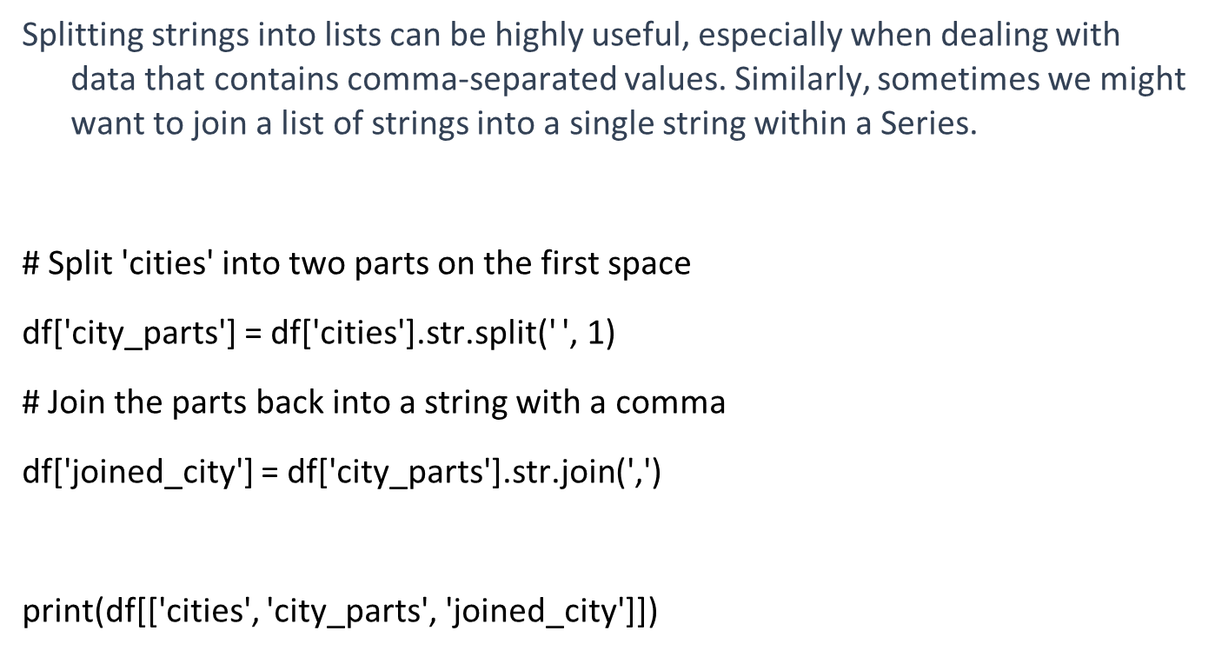

Slide 38
Output
cities city_parts joined_city
0 Old York [Old, York] Old,York
1 Los Angeles [Los, Angeles] Los,Angeles
2 Chicago [Chicago] Chicago
3 Houston [Houston] Houston

Slide 39

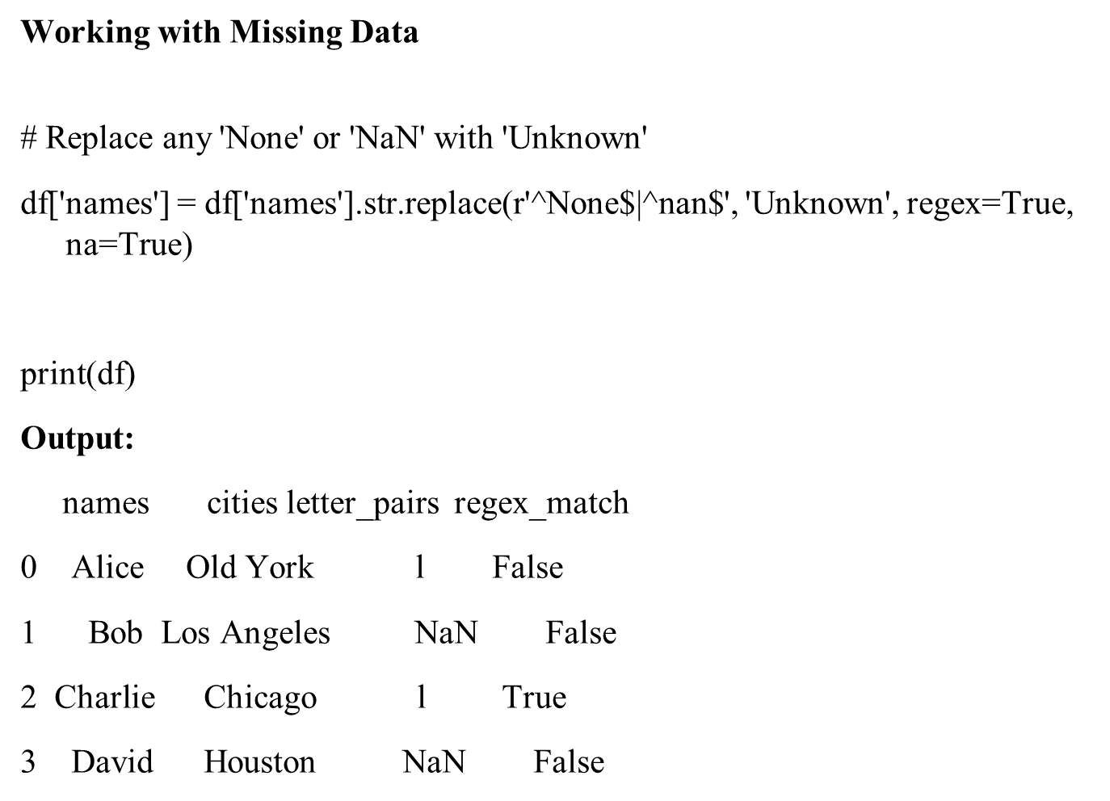

Slide 40

With pandas, we can concatenate columns of strings straightforwardly using the plus sign (+) or the cat() method.
# Concatenate names and cities with a separator
df['name_city'] = df['names'].str.cat(df['cities'], sep=', ')
print(df[['names', 'cities', 'name_city’]])
Output:
names cities name_city
0 Alice Old York Alice, Old York
1 Bob Los Angeles Bob, Los Angeles
2 Charlie Chicago Charlie, Chicago
3 David Houston David, Houston

